Slide 1



PYTHON PROGRAMMING MINI PROJECT REPORT TOPIC:VIRTUAL VOICE ASSISTANT IN PYTHON
Group 8 G1 Batch:
Parmeet Bhatti 16010421009
Vedant Dhotre 16010421020
Parth Gala 16010421025
Faculty: Prof. Rupali Patil
Prof. Vaibhav Chunekar

Slide 2

PROBLEM STATEMENT:
To write a program to create a Virtual Voice Assistant in Python by Speech recognition using inbuilt API(Application Programming Interface) helping convert input audio to text aiding in performing certain tasks as per user request.
User can give commands to perform various tasks such as searching anything on google and Wikipedia, opening a website, playing songs from the user's system, viewing news headlines, search for a place in google maps, ask to show the time, set an alarm and timer, tell jokes or greet the user. The user can suspend the voice assistant by saying "Thank You" or “Bye".

Slide 3

SYSTEM ARCHITECTURE:
Speech Recognition (using google Speech recognition API)
Processing of User Input based on Trigger Words
User Input
(Speech)
Output according to User Input in text and audio
Opening URL’s, Playing Music, Setting an Alarm or Timer, etc

Slide 4
1. LIBRARIES USED:
pyttsx3-pyttsx3 is a text-to-speech conversion library in Python. The pyttsx3 module supports two voices which include a female and a male voice, provided by “sapi5” for windows.
speech_recognition as sr- Speech recognition is a machine's ability to listen to spoken words and identify them. SpeechRecognition library has many classes but in our project we have used a class called Recognizer. This is the class that will help us to convert audio files into text.
wikipedia-Wikipedia is a Python library that makes it easy to access and parse data from Wikipedia.

Slide 5

datetime -datetime is a module used to work with dates and times.
json -Python comes with a built-in package called json for encoding and decoding JSON data.
urllib.request -The urllib.request module defines functions and classes which help in opening URLs.
playsound -The playsound module is a cross platform module that can play audio files. It works with both WAV and MP3 files.

Slide 6
webbrowser -The webbrowser module provides a high-level interface to allow displaying web-based documents to users.
pywhatkit - pywhatkit is a simple and powerful Python library with many useful features such as Playing a YouTube video, Performing a Google Search, Getting information on a particular topic and Sending WhatsApp messages. In this program pywhatkit has been used solely for the purpose of performing a google search.
os - The OS module in Python provides functions for interacting with the operating system like creating and removing a directory (folder), fetching its contents,etc.
pyjokes - he pyjokes is a python library that helps to create one-liner jokes.

Slide 7
re(regular expression) - A regular expression specifies a set of strings that matches it; the functions in this module let you check if a particular string matches a given regular expression.
time - time module in Python provides various time-related functions.

Slide 8
FUNCTIONS(USER-DEFINED):
def speak() – Function created to to give audio output according to user input. Works in accordance with module pyttsx3.
def wishMe() – Greets the user according to the System time information received by module datetime. This function is called at the very beginning of the program.
def takeCommand() – Takes voice input according to pre set input audio intensity. This function also recognizes the input audio using Google’s Speech Recognition API. This Function is integral for the execution of the program.

Slide 9
def lastWord() – This function helps in attaining the last word of a string. It helps in making the code less repetitive.
def seclastWord() – This function returns the second last word of a string passed as an argument, with the help of regex. Again it helps in making the code less repetitive.
def taskExec() – The most important part of the program. This function contains all tasks/commands to be performed when the user gives a voice input. Tasks are performed if a trigger word/phrase is found in the user’s voice input. All tasks which can be performed by the voice assistant are explained in the upcoming slides.

Slide 10
API Extraction:
APIs act as an intermediary, allowing websites and software to communicate and exchange data and information. APIs can be thought of as a website or app’s custom-made communication protocol. It has certain rules to follow and needs to speak its language before you communicate with it.
Hence an API key has been created to direct all service requests. This API key as a communication link between the website and program.
In this program we have used API for Data Extraction instead of more popular approach of Web Scraping. JSON data from the website is extracted and then processed to give output.

Slide 11
Features of Designed System:
User Input Audio is taken from System Microphone and recognized by Python modules pyttsx3 and speech_recognition.
Certain tasks are performed by the program based on Audio Input given by users. Trigger Words/Phrases have been provided to the program in a set of if else statements.
When a Trigger Word is hit, the Program executes a set of commands to provide the correct response as per User request.
When the program does not recognize audio input, it prompts the user to give audio input again. This will repeat up until the programs deems an audio input to be substantial, hence eliminating major ambient noise or audio not meant for the program.
The Program is User Friendly as it not only provides Audio output but also text output displayed on screen for the better accessibility.

Slide 12
Major/Important Tasks which the program can perform are:
Search User’s Request on Wikipedia and Google.(User can choose which portal to search on)
Open any Website
Play a song from the User’s Playlist stored on their device.
Tell the current time
Set an Alarm and Timer
Ask for the location of a place(city or country) on Google Maps
Show the Top Headlines(News) of the Day
Suspend Listening or taking audio input for a duration specified by the User

Slide 13
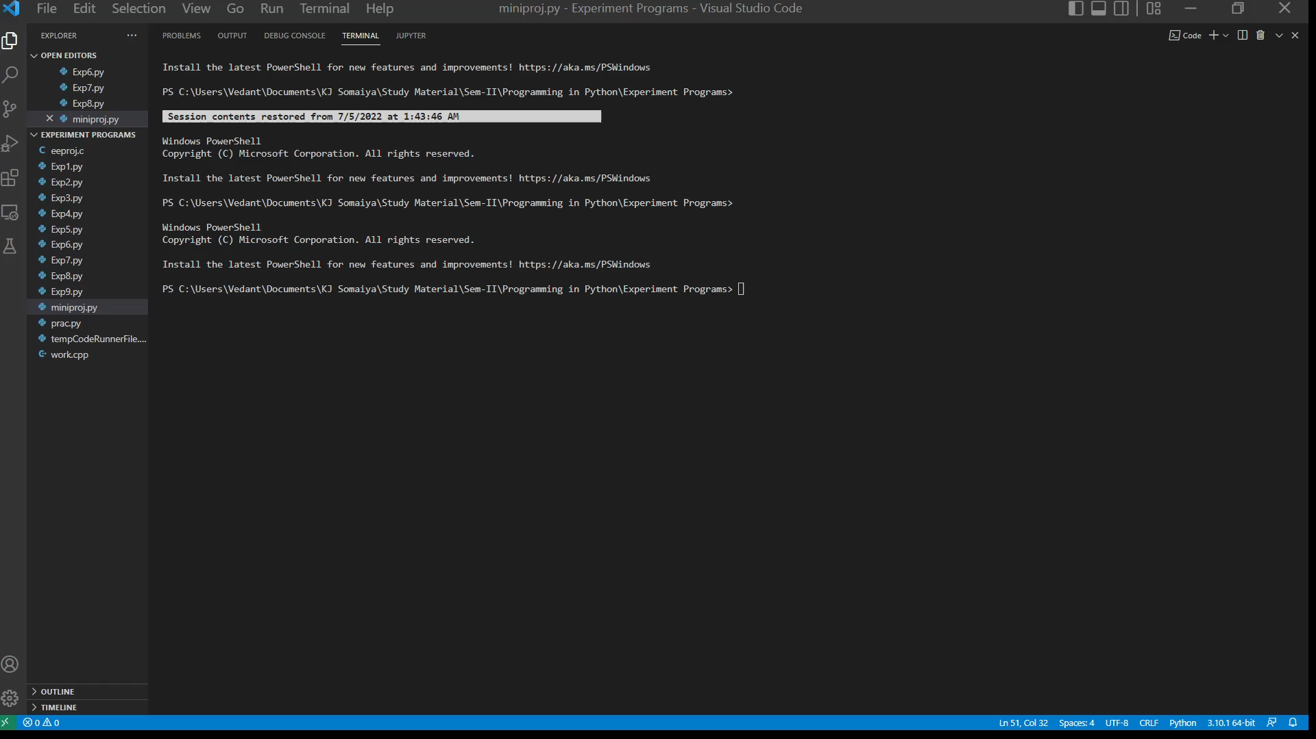
Result/Output:

Slide 14
Conclusion:
Successfully made a Virtual Assistant Bot.
Learnt new libraries and what their usage is.
Learnt how to open URL’s from Python.
Learnt Data Extraction from website APIs
Learnt how to get date and time information from User’s system
Learnt how to read JSON file format and implement data in the program.

Slide 15
References:
https://www.geeksforgeeks.org/speech-recognition-in-python-using-google-speech-api/
https://www.webscrapingapi.com/beginners-guide-extracting-data-apis/
https://www.youtube.com/watch?v=LLZQT9-0l_8
https://newsapi.org/
https://www.geeksforgeeks.org/python-text-to-speech-pyttsx-module/
https://docs.python.org/3/library/datetime.html

Slide 16
THANK YOU

